Slide 1
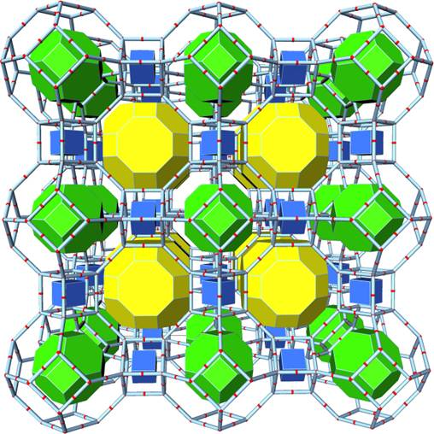
Green Approaches towards Waste disposal
Dr. Abbas Ahmad Shah
Associate Professor,
Department of Chemistry,
GDC, Boys, Anantnag.

Slide 2
Layout of the presentation
What is waste?
Is all the waste really the waste?

Slide 3
What is waste?
According to the definition, thrown away substances or unwanted materials considered to be defective or worthless constitutes the waste.
Some other names of waste are junk, garbage, trash, rubbish, etc.
Household disposals, unused plant biomass, wastewater, municipal solid waste, waste energy, and others are the examples of waste.

Slide 4
Is all the waste really the waste?
Of course No, as the recent developments in research has somehow answered this question.
Instead of using conventional methods of disposal, most of these wastes are now-a-days being recycled into special materials with valuable importance.
Wastes like slags, clays, ashes (husk ash, oil palm ash, and coal ash) and naturally occurring rocks all of which contain abundant Si and Al has been utilized to synthesize multipurpose aluminosilicates in order to dispose them off and to generate low cost and commercially valuable materials.

Slide 5
Recently, the emphasis has been on the utilization of industrial and municipal wastes as heterogeneous catalysts to tailor chemical reactions to products. These wastes (e.g. municipal waste, biomass, coal fly ash etc.), contain active mineral elements that confer catalytic properties on them.
Scientists are focused to use bioremediation as a tool for converting untapped source of energy in decaying materials such as leaves and dead organisms into useful energy. Such processes already occur naturally in sediments as they are rich in organic materials formed from the breakdown of decaying materials.

Slide 6
Agricultural waste containing lignocellulose biomass has been explored as possible precursor for the production of activated carbon.
Wastes from fruits in the past decade use to constitute menace to the environment but with the advent of research to find alternative to the pricey commercial activating carbon, the feasibility of converting such wastes into large surface area carbon has been investigated and brought to limelight.

Slide 7
THANKS

